Slide 1
INFINITY MODEL PPT (HTML)
We learnt about the new education policy (nep) and even the curriculum the things we would be learning in the web technology lab and coding languages to be learnt.
Even the marking scheme and gave the details of the micro project.
Started with HTML (HyperText Markup Language) which is the standard language used to create and structure web pages. It defines the content and layout of a webpage using elements and tags. HTML works across all browsers and operating systems.
HTML uses tags like <h1>, <p>, <img> and <a> to define headings, paragraphs, images and links.

Slide 2
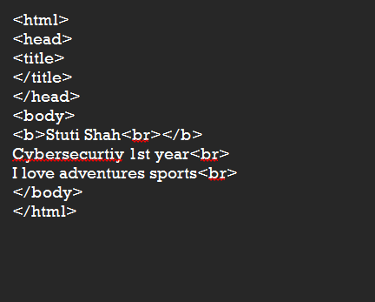
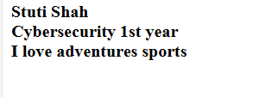
Code 01:
In this code we have learnt the basics of html and the order it should be written in.
This code taught us about the tags like <b> and <br> which represents bold tag to make the font bold and break tag to start the new contact.
Input:
Output:

Slide 3
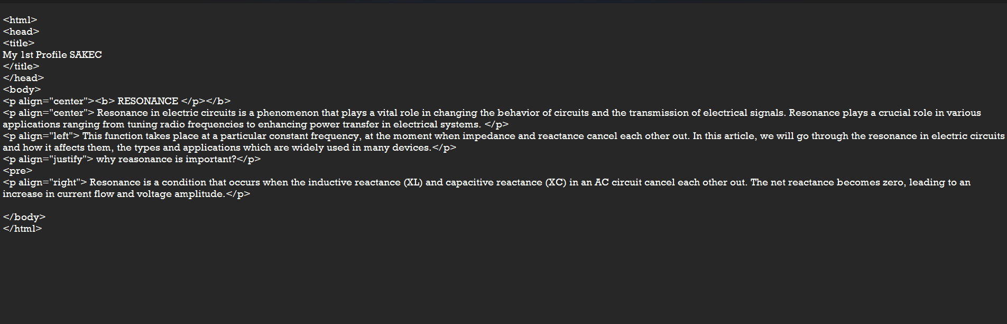
Code 02:
In code 2 we have learnt about the paragraph tag <p> which is used to display paragraph content.
In brief about paragraph tag, we learnt about alignment which is an attribute of the paragraph tag used to align text in center, left, right or justify.
We learnt about the pre tag <pre> which is used to display the content as it has been written in the code.
Input:

Slide 4
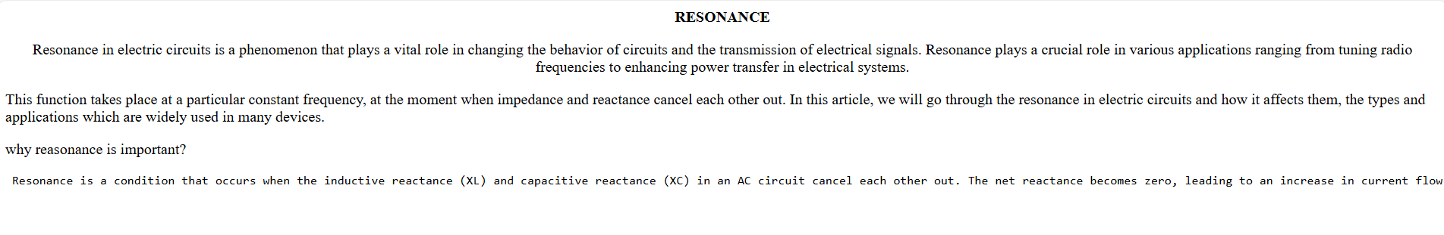
Output:

Slide 5
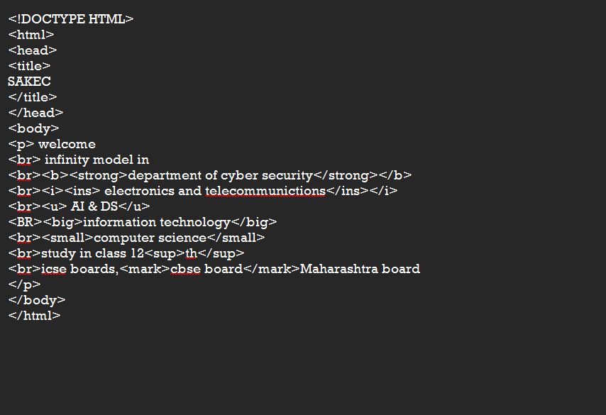
Code 03:
In code 3 we learnt about some new tags as well as some tags which have same use but different names they are:
To bold the text we can use <b> or <strong> tag
To have italic font we can use <i> or <ins> tag
To underline text we use <ul> tag
To increase a font size use <big>
To decrease a font size use <small>
To supper script a text use <sup>
To subscript a text use <sub>
To highlight a text use <mark>
Input:

Slide 6
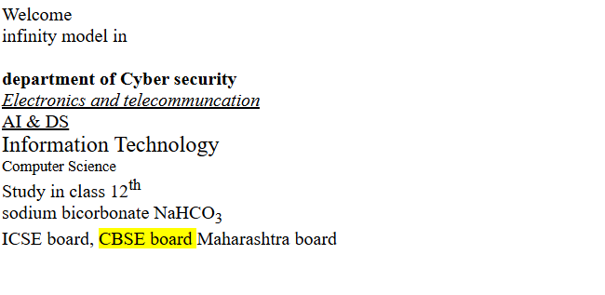
Output:

Slide 7
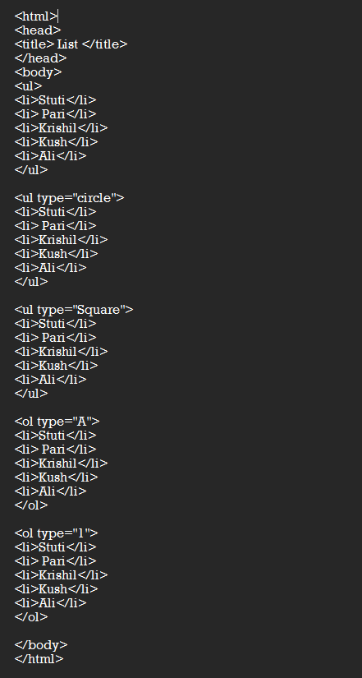
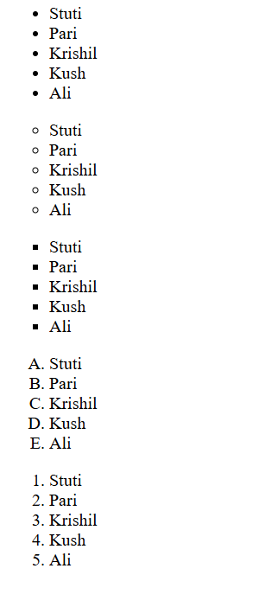
Code 04:
In code 4 we learnt about the list the which are ordered and unordered designated by
<ol> and <ul> respectively these have further <li> tags which is used to list the data under a list tag
The attributes of the ol tag and ul tag help to change the bullets for eg <type=”square”>
Input:
Output:

Slide 8
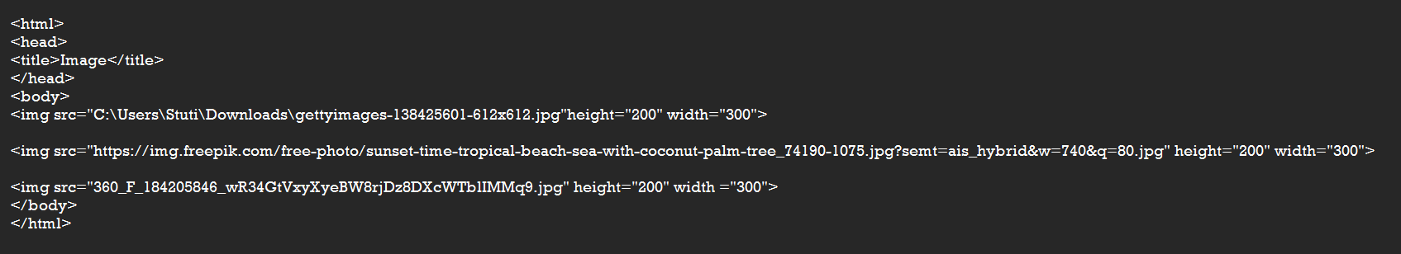
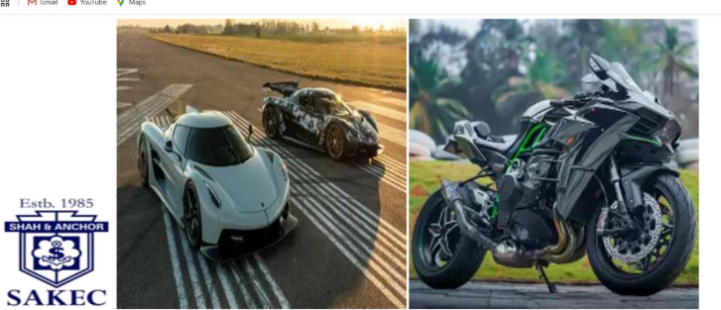
Code 05:
In code 5 we learnt about how we can insert an image in our website by using <img src> tag
This tag has attribute to set the height and width of the image < height="500“ width="500" >
We were also taught different ways to insert an image being y saving an image in the designated folder as a .jpg file and calling it in the tag another way being by using the path link of your stored image and pasting it in the tag and the last being using an
online image without downloading directly pasting its link.
Input:
Output:

Slide 9
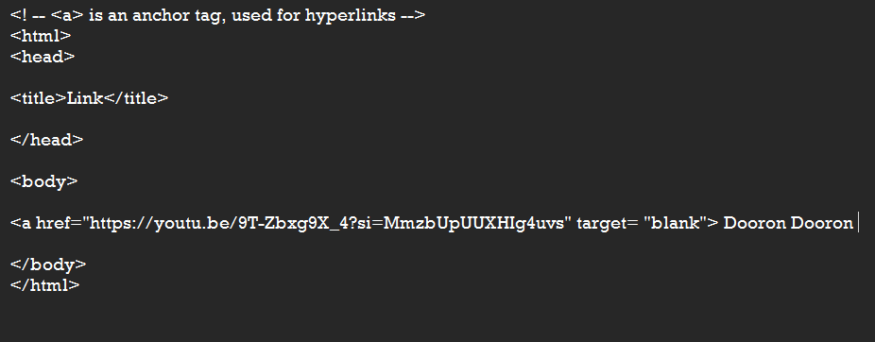
Code 06:
In this code we learnt about hyper links which are used to move between different pages of a website by the tag <a href>
The text written in this tag when clicked takes the user to the designated site link pasted
Input:
Output:

Slide 10
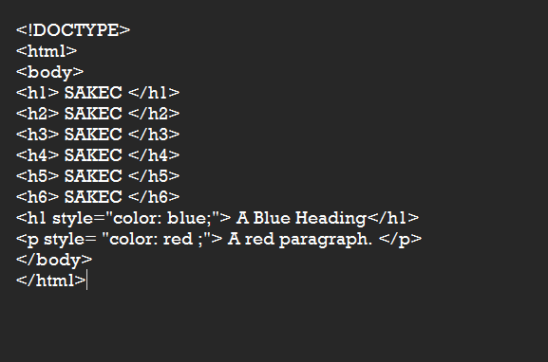
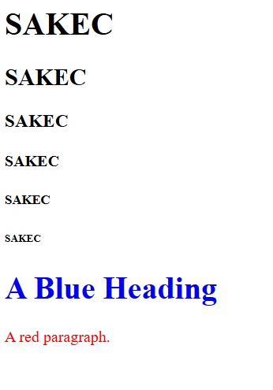
Code 07:
In this code we learnt about the heading tag <h1> being the biggest and <h6> the smallest
Also did we learn about the attributes of the heading tag to change color of the text
Input:
Output:

Slide 11
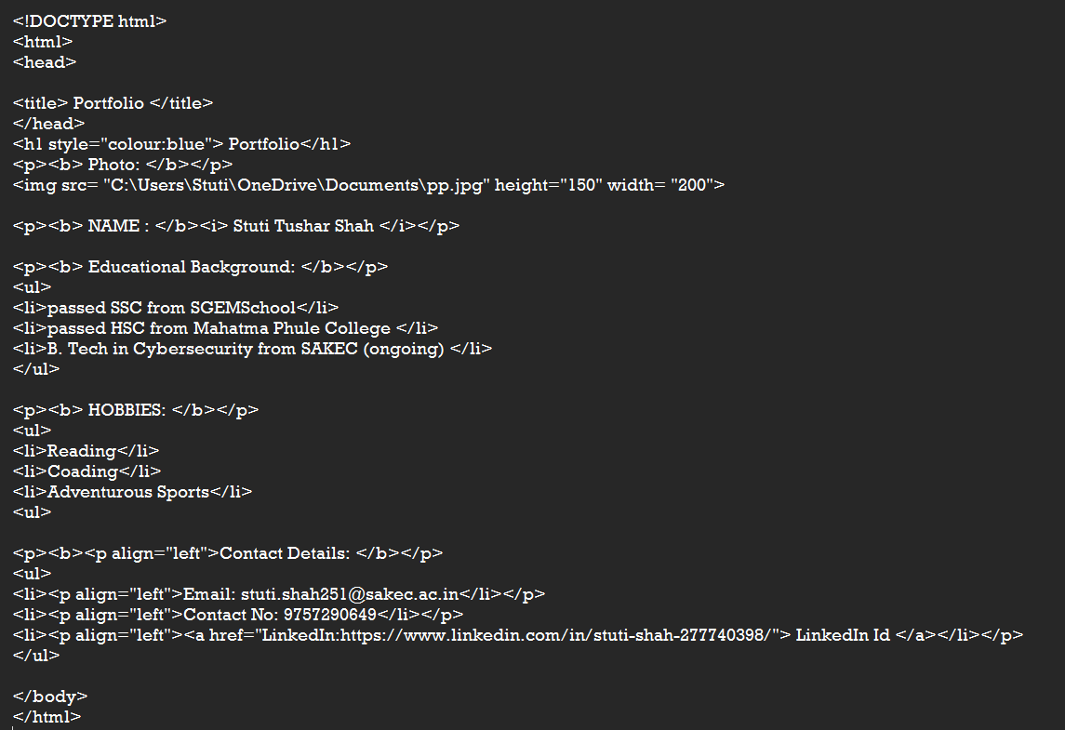
Code 08:
This code was designated to display a profile about yourself using what ever we had learnt till now
Input:

Slide 12
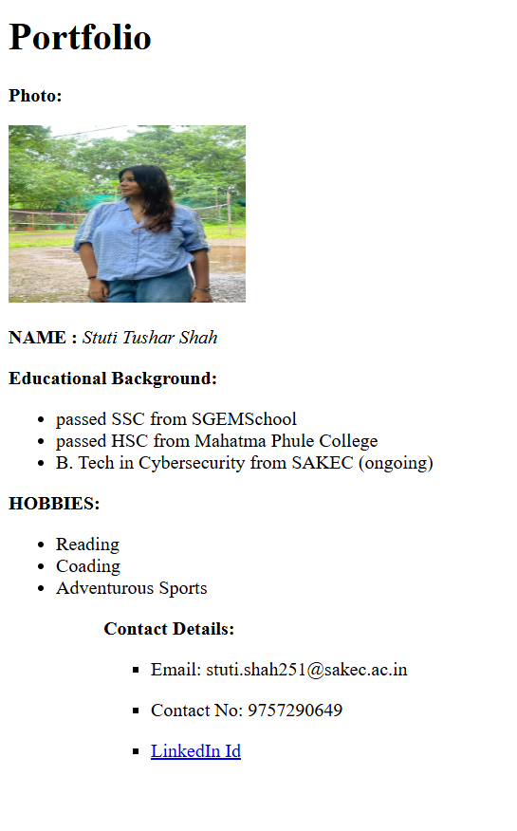
Output:

Slide 13
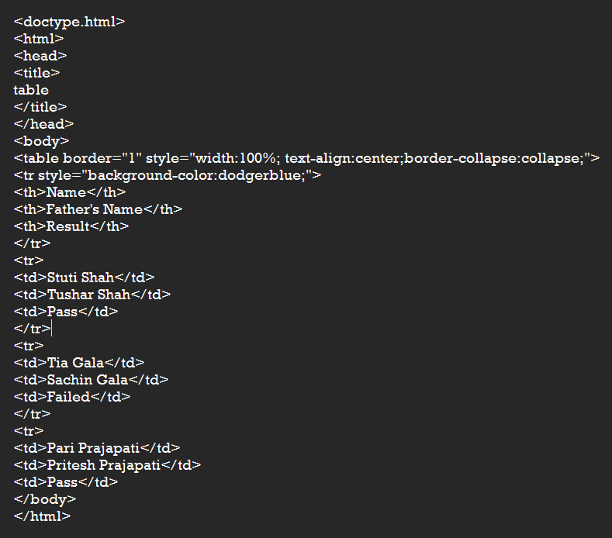
DAY 02:
We stared html again and the codes are as follows:
Code 1:
We learnt about how to make a table using codes it starts by using <table> tab to open a table it also has attributes to set table border cell spacing and alignment
Then we use <tr> tag to enable a new row <td> tags to write the content of the row and so on.
Input:

Slide 14
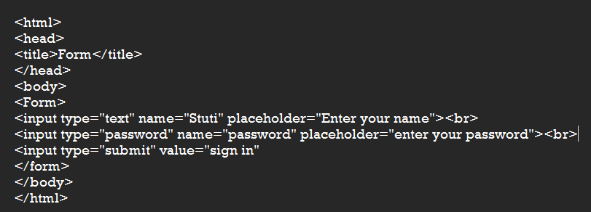

Output:
CODE 02:
In this code we learnt hoe we can insert a form in a page by using <form> tag
The form tag uses <input> tag which has css to style the type of content being entered <input type="text" name="sname" placeholder="enter your name"> type defines text or numbers and place holder acts as the text displayed in the cell.
Input:
Output:

Slide 15
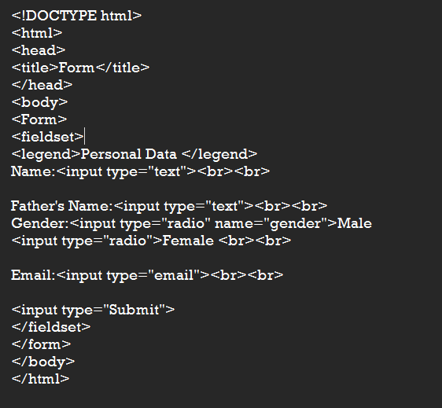
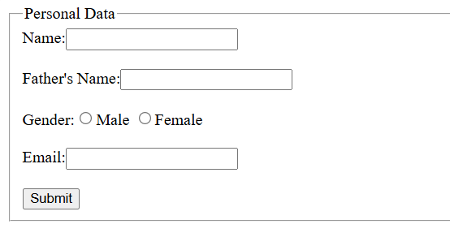
CODE 03:
This code made us learn additional styling in form tag
We used <fieldset> tag which makes a box around the form
We used the <legend> tag which gave a title on the fieldset
We also learnt different types of input <input type="radio“ name="gender">female<br><br>
Input:
Output:

Slide 16
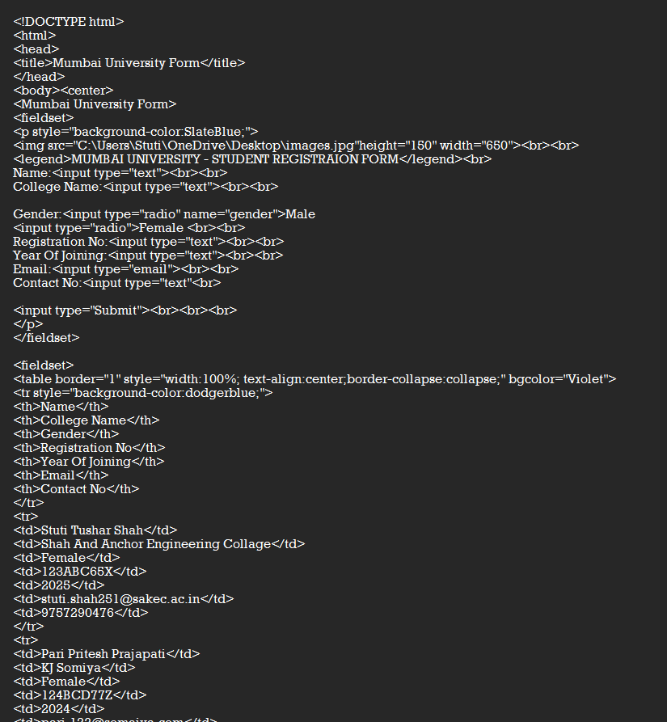
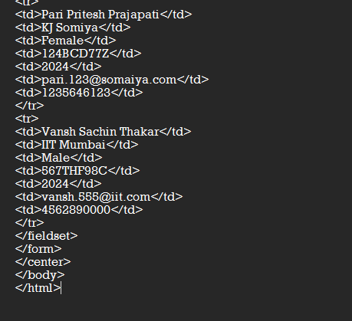
CODE 04:
In code 4 we designed a page for college students to enter their detail as Mumbai university site
We designed a table to store the data using tables
Input:

Slide 17
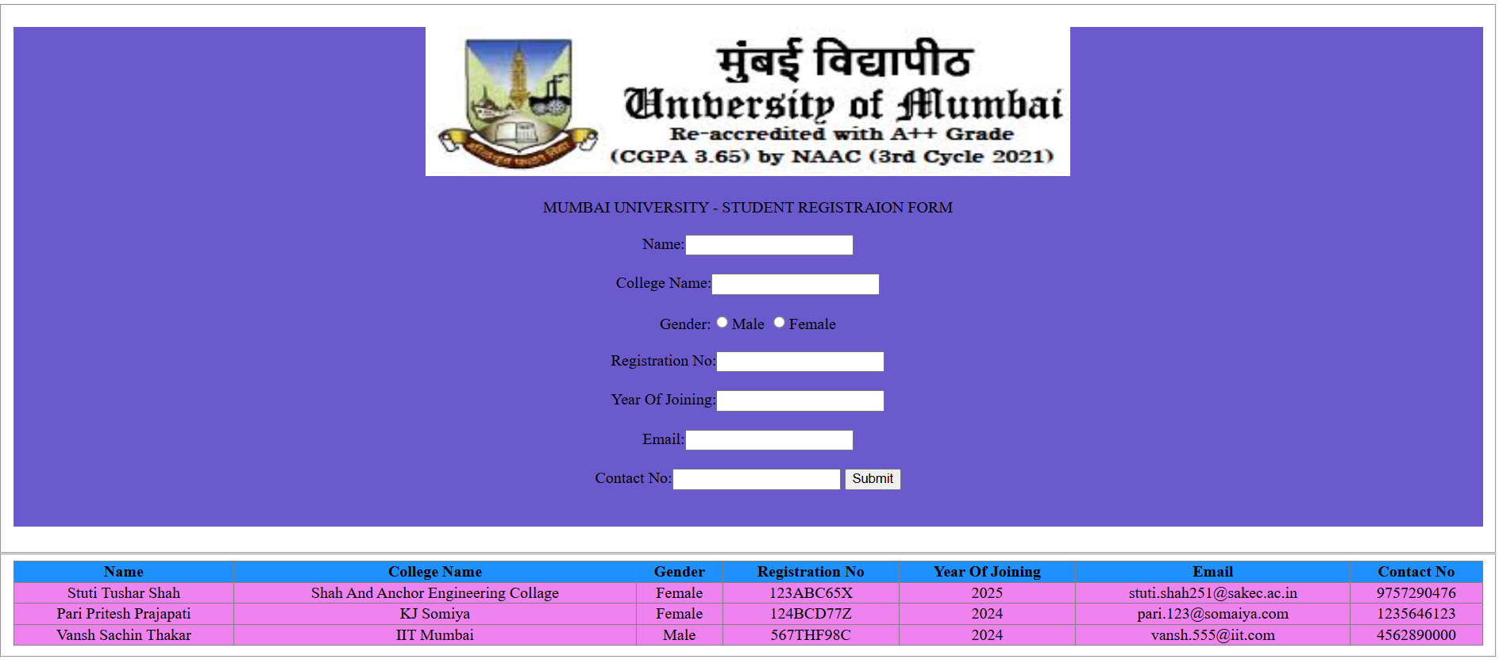
Output:

Slide 18
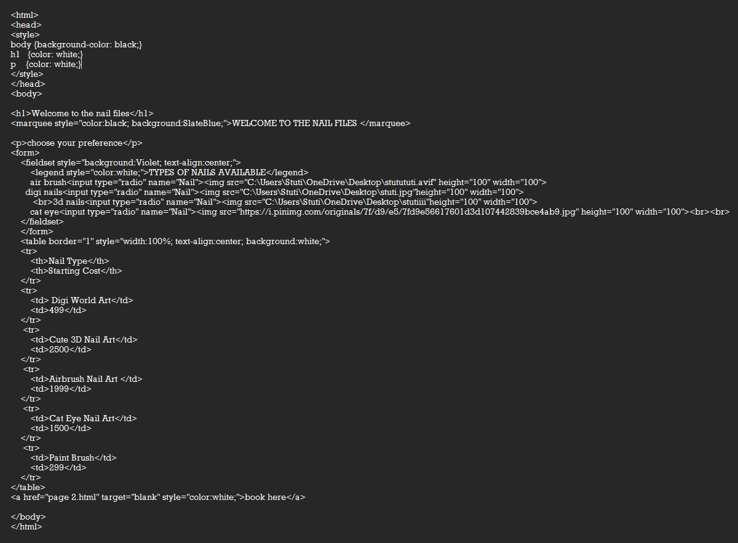
CODE 05:
Code 5 was an experiment to design a inteactive web page with all the learning in 2 days
and our creativity by using internal css inline css and external css in a code
Input:

Slide 19
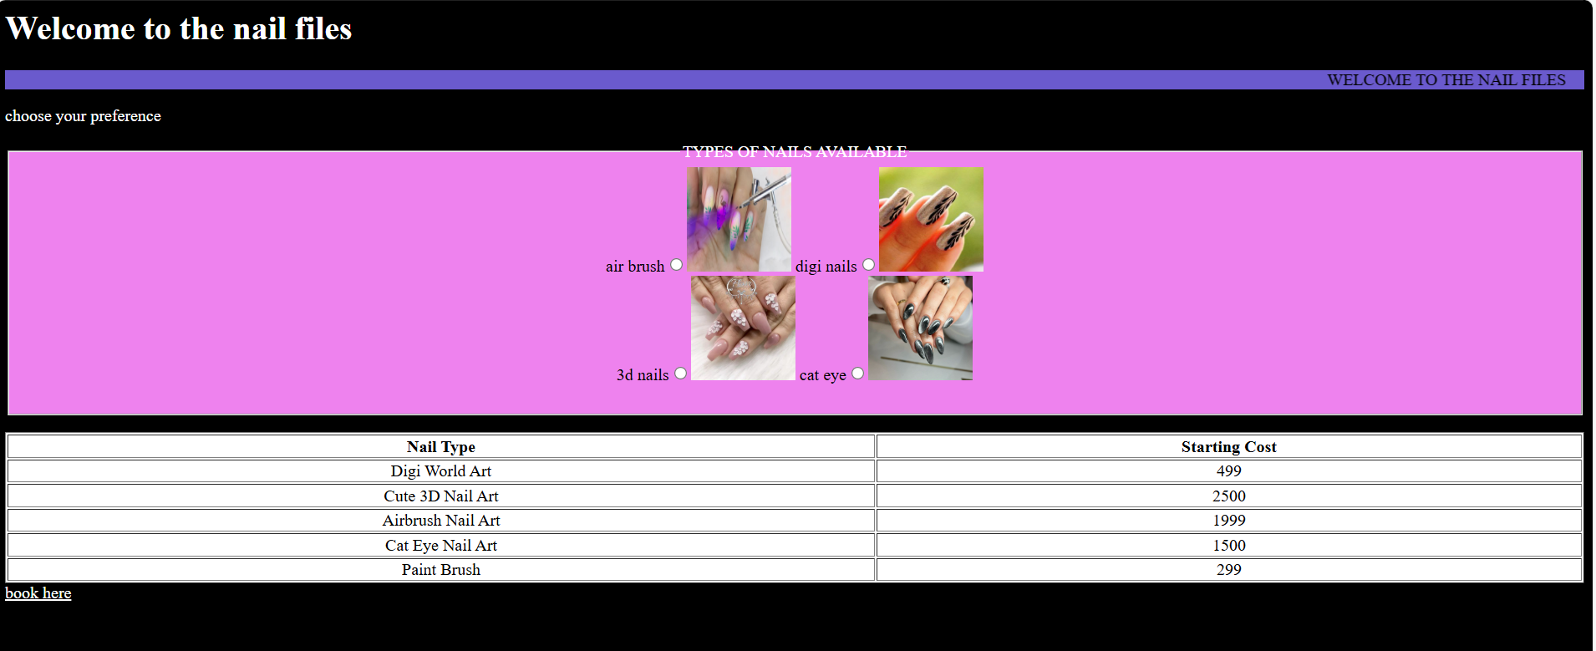
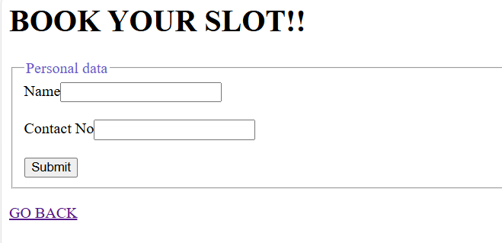
Output:

Slide 20
THANK YOU

